Slide 1

Social Media: Fight, Flight, or
The Shifting Role of Organization Development
in Business
Presented for St. Louis Organization Development Network
Social Media
pic source: frankjkenny.com/wp-content/uploads/2011/11/facebook.jpg
Notes:
Social Media is user-generated content supported by tools that enable collaboration
Social media speeds up information and communication. The faster the communication, the bigger the need to create filters against communication saturation.
Speeding up information increases the need react/respond. Is this a good thing, just reacting fast is not reacting correctly. Command and control is out of whack. Are we confident in the skills and abilities of others?
Chaos is the place where possibilities occur.
Learn
Act on what you’re hearing
Shine a light on others’ ideas
Innovate
Measure and notice what’s working
Apologize when you screw up
Encourage your team to explore and take new risks
Try new stuff. Repeat

Slide 2

Why are we here and what are we going to do?
Me
You
Community
What is and what is not?
What are we doing in the name of development?
What can we do in the name of development?
x
pic source modified from: http://www.s3talentmanagement.com/images/graphic-development_center.jpg
Notes:
What is and what is not?
How many people work in OD, OB, Odesign?
What is change management?
What is organization development?
What is an intervention?
Where does organization development start and stop?
Who thinks they are in public relations? Marketing?
What are we doing in the name of development?
Does anyone have a definition of what social media is? Let’s not define it just yet.
Development – will include a breakout I prepared
Change community and trust. Who delivers message, who has clout?
What can we do in the name of development?
Social media nexus

Slide 3
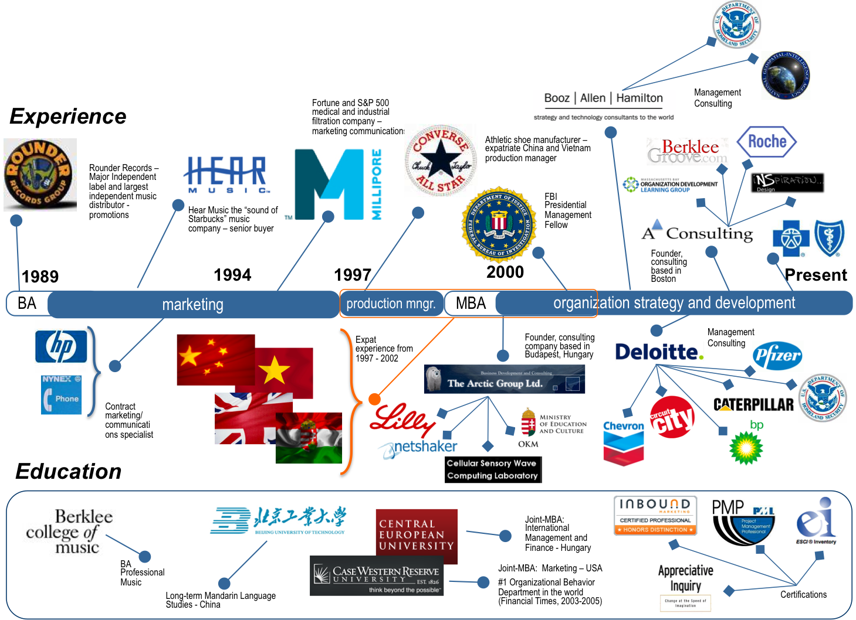
Why am I here and what is the context
Me
Notes:
Career
Thread
Harsh reality

Slide 4

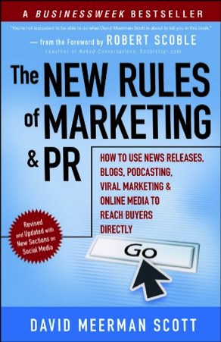
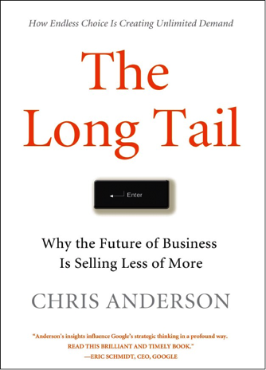



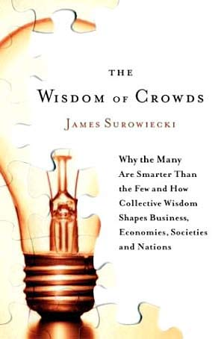



My discovery of the new world of marketing and buy-in
Me
Education/Source Timeline
Case Western Reserve University
Marketing and International Finance
Emotional Intelligence
Richard Boyatzis
Appreciative Inquiry
David Cooperrider
1999
2007
Present
Learning about community
www.TobyElwin.com/blog
Notes:
I hate the term buy-in and wondered why commitment, understanding, and motivation
People kept recommending each other, openly, and transparently, and consistently
I realized how little I knew
Read some quotes

Slide 5
What is and what is not?
Me
You
Community
What, exactly, do you do?
Defined
In theory
In practice
  What is an intervention?
  What are the qualities of a successful intervention?
Organization Development
Principles
Law
Reality
Notes:
These are not laws, but principles
School of science,
the thinkers,
the techniques, AI
the tools, Kotter

Slide 6
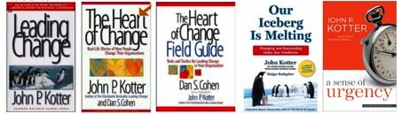

Leading change
Me
You
Community
Increase
Urgency
Build
Guiding
Team
Get
Vision
Right
Comms
for
Buy-in
Empower
Action
Create
Short-term
Wins
Don’t
Let Up
Make it
Stick
Change as a journey of fellowship
pic source: http://www.cinemasoldier.com/storage/post-images/lord-of-the-rings-beacon-of-gondor.jpg
Notes:
Buy-in – commitment, understanding, and ownership

Slide 7
Questions along the valley of despair [change curve]
You
If their questions were not anticipated and clear answers not provided:
you are not communicating
pic source modified from Deloitte Consulting

Slide 8
OD, manage a process or enable a promise
You
Information, communication, or community – the return on involvement
Awareness
Understanding/ Involvement
Training/ Acceptance
Implementation/ Transition
Follow up
What is the transformation about?
Why is there a need for it?
What major changes will occur?
How will my organization be different?
What does it mean to end users?
What is the timeline for significant events?
How will the changes impact me and job?
What are my new roles and responsibilities?
How can I influence the changes?
What new functionalities will be provided?
How will the current processes change?
How will the progress be measured and reported?
Where do I go to find more information?
How does the change/process/technology work?
How will the changes help me?
What are my new responsibilities?
What support will I have after training?
Who are the primary points of contact
Who can answer my questions?
How will the changes be implemented?
Who can I call if I have problems?
When will the changes be implemented?
How are the customers adapting throughout the transition process?
What communications channels are working/not working?
What kind of concerns do the customers have?
What are the lessons learned?
Do you develop communication that clearly answers: What’s in it for me?
pic source modified from Deloitte Consulting
Notes:
Process versus promise process you manage or engagement you enable
There are many reasons why communication is important for the change effort, a few of these include:
People need information to make change happen.
Without good information, people make it up.
Lack of information breeds uncertainty…and anxiety.
Anxiety interferes with focus and productivity.
People assume their managers “know”.
Information-sharing gives people a sense of belonging.
People work harder for organizations they feel a part of.
Communication stimulates new ways of thinking.
Honest, timely communication enhances credibility.
With good communication, people will rely on the company (vs. the grapevine or the press) for accurate, up-to-date information.

Slide 9
Social media leading change
Me
You
Community
Social media principles … or organization development principles
Discern
Diagnose
Design
Deliver
  Monitor/Measure
  Modify
  Magnify
Information versus Communication
The grand rule of communication: know your audience.
Information is one-way (display)
Communication is two-way (feedback, adjust)
Always filtered through WIIFM (What’s in it for me!)

Slide 10

Marketing 1.0 – one-way, outbound
Community
The brilliance of my product is the synergies I’ve created in a game-changing platform that will revolutionize and vertically synergize your world like you’ve never thought about before – me, me, my, my, I, I, blah, blah
pic source: http://www.flickr.com/photos/pburch_tulane/4195280723/in/photostream/
Notes:
Stats on the filter

Slide 11
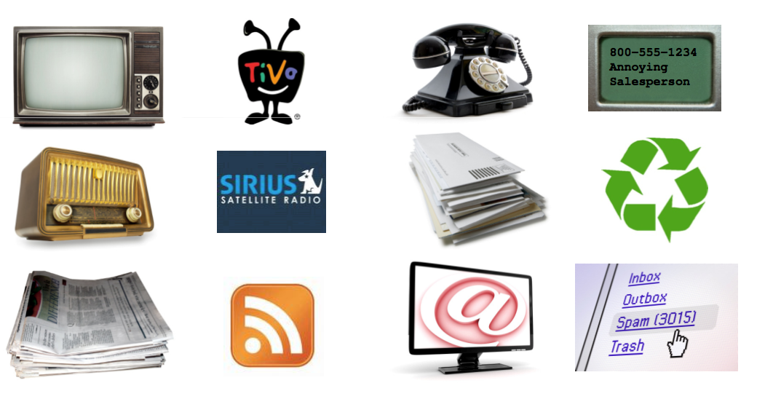
Communication saturation filters
Community
Marketing 1.0 – one-way, outbound
Advertising
Direct Marketing
Filter
Filter
source: hubspot.com
Notes:
News by CBS for CBS viewers
The Internet has changed the dynamics of the business world. For the past decades, marketers have used “outbound” marketingn techniques such as trade shows and print advertising, where marketers push out a message far and wide hoping that it resonates with a few individuals. These outbound marketing methods are becoming less and less eﬀective for two reasons:
People are getting better at blocking out interruption‐based marking messages.
The average person is inundated with thousands of outbound marketing interruptions per day and is ﬁguring out more creative ways to block them out, including caller ID, spam ﬁltering, and on‐demand TV and radio.
The Internet presents quick and easy ways for consumers to learn and shop.
Instead of flying to a trade show across the country, for example, a consumer can go the Internet to research and purchase products or services.
Today, consumers are going to the Internet to start their purchasing process. In order to remain competitive, businesses need to utilize “inbound” marketing techniques to “get found” by the consumers searching for their products and services online.

Slide 12

Marketing 2.0 – two-way, inbound
Community
pic source: http://www.inc.com/magazine/20100301/ceo-passions-hosting-benefit-concerts.html

Slide 13
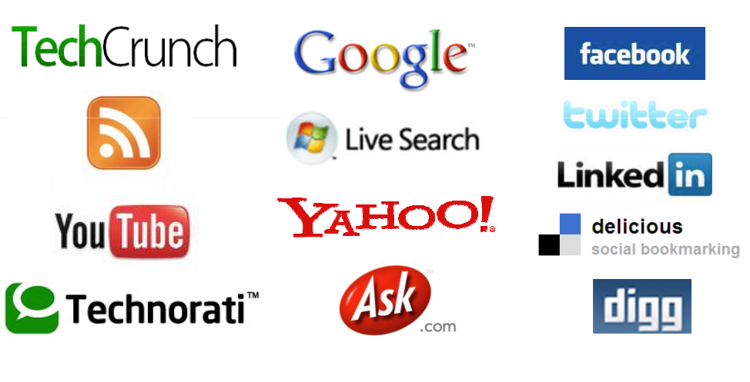
Marketing 2.0 (inbound)
Community
Search Engine Optimization
Blog
Social Media
source: hubspot.com
Notes:
73% of all purchase decisions are now researched first online
73% of online users read blogs
57% of online users join social networks
83% of online users have viewed a video online
39% of online users subscribe to RSS Feeds
Source: Universal McCann International Social Media Research

Slide 14




Where’s the party?
Community
pic source: http://buprssa.files.wordpress.com/2010/04/4511173458_98b3a86c24-1.jpg
pic source: http://ilays.com/online/wp-content/uploads/2011/09/un-MEETING.jpg
Notes:
Provide value – you’ll gain trust and attention
Support the community – put others above yourself
Create conversations
Request and listen to feedback; let other users of the site be your teachers and informants
Demonstrate integrity – you are transparent on the web and integrity matters
Have fun – don’t prejudge connections – you never know where someone will lead you

Slide 15

From: command/control, To: contribute/collaborate
Me
You
Community
Marketing 1.0 the distribution is the value; command and control
  Community
  Transparency
    only 14% of people trust advertisements
    78% trust the recommendations of other customers
Marketing 2.0 the content is the value; contribute and collaborate
  Get found
  Be sticky
  Call to action
1 - Get found
2 – Be sticky
3 – Call to action
pic source: 1) http://www.slideshare.net/HubSpot/2-imu-seo-crash-course-to-get-found-gf102 2) http://www.childfirstpediatrics.com/web-hosting.jpg
Notes:
14% Forrester and 78% Nielsen Global Online Consumer Survey April 2009 /
[get found, convert, measure what matters]
Content is remarkable when someone defines it as remarkable, not when your marketing or product manager define it as remarkable. This is the greatest challenge in today’s world of marketing.
You really have no control over your product’s value, however, you do have control about hosting and socializing with people who will advocate, refer, and recommend your service or product. So, your strategy relies on enabling others.
if you provide valued content and there is a link and contact information, people will find and recommend you [would you rather have 100 leads of dubious quality or 10,000 downloads and 50 responses? Know what Google search engines value];
think like a publisher and make all content valuable for every flavor of your customer;
make sure it is easy for us to forward your information, if we find it valuable, we will distribute it for you, when it is really valued we even recommend it;

Slide 16
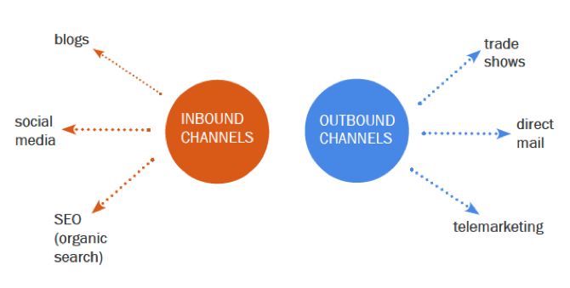
The engagement strategy
Me
You
Community
Persona design
What answers can you provide for what they search for
Keywords
Key phrases
Think like a publisher – compelling content, unique to them
Think like a publisher – compelling content, unique to their community
People search for answers to their questions, not your content
Focus on the keywords and phrases that buyers use
Who are your clients? Prospects?
What are they interested in?
What do you want to hear from them?
What do you want to talk to them about?
Segmentation
What value can you offer?
What are your goals?
pic source modified from: http://www.hubspot.com/download-the-2012-state-of-inbound-marketing/
Notes:
Compelling Content
make sure there are always links back to a source or call to action, always make it easy for us to dig deeper;
stop spamming press releases, journalists Google you, they don't look at a stack of your jargon-filled press releases;
post all your news and press releases on your website, that's where we go for your news and that is where Google goes to index your information;
go where your audience is or provide all the tools for your audience to build their own happening;
stop co-opting Twitter, You Tube, and Facebook, we are faster than you;
when you provide content you build organically: become the source for information and problem solving and you and your company will become known;
ask permission;
forget about your viral campaign, provide value and we make your content viral
we don't care about you or your product, we care about how you or your product makes our life better - so get to the point wwithout jargon, better yet, if you come recommended, I will find you

Slide 17

Persona - the best of community
Me
You
Community
Identify the persona(s) of who needs your solution?
Investigate words and phrases they use to describe problems?
  Search engines answer questions
  3 and 7
Develop content that describes issues and problems they have faced and then provides details on how to solve these problems
  What are their problems?
  What keeps them awake at night?
  What do they want to know?
From leading to contributing
pic source: Leadership-Pegs.jpg
Notes:
http://www.buyerpersona.com
Tips
How can you reach each buyer persona
develop compelling messages
interview them
identify the buyer problems your product/service solves
find out the media your buyer persona uses – where do they hang out
Identify any gaps in your initial buyer persona
Identify the ways you’re your buyer speaks and match that
your online presence should not be a one-size fits all product
write for the buyer, not for what you want to sell
understand the words or phrases of your audience (buyer persona)

Slide 18
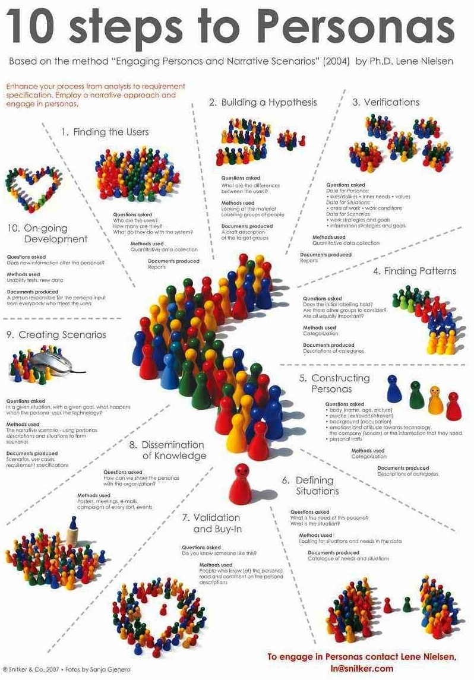
To get found, find out about persona
Me
You
Community
Your buyer is faced with problems, develop topics that appeal to them
Measurable ROI (Return on Involvement)
What’s in it for Me?
What’s in it for Them?
  WIIFT?
Answer WIIFM? with WIIFT?
Create an archetype of your buyer persona with all the details you can provide:
  what the user does,
  is motivated professionally by,
  reads, works, is interested in
The goal is to understand this person's motivation and need.
  What’s in it for them now provides answers to What’s in it for me
Notes:
http://www.hceye.org/HCInsight-Nielsen.htm
Lene Nielsen wrote her Ph.D. thesis Engaging Personas and Narrative Scenarios in 2004. She is usability consultant at Snitker & Co., Denmark. She is also the international mentor for HCI Vistas Global Initiative.
http://www.hceye.org/UsabilityInsights/?p=89
The best web strategy positions your web page not as a brochure or an advertisement, but a rich source of content.
The best web strategy, like the best magazine, provides content over just look – form over function. Not all of your site’s visitor’s have to be buyers, but they should leave as advocates.
Today’s marketing relies less on information (a one-way flow of thoughts and ideas) and more than ever on communication (a two-way flow of thoughts and ideas). Social media and the Internet are conversations, referrals, and filters. Like a dinner party, no one on the Internet will tolerate an individual who monopolizes the conversation or directs others to talk about only their interests.

Slide 19
Keyword meritocracy and persona identification
Me
You
Community
Persona matrix worksheet
The Person | Who are they? | Why are they interested?
The Hypothesis | Work conditions Work strategies and goals? | Information strategies and needs
Verification | Likes/Dislikes Inner Needs Values | Area of Work Work Conditions
Defining | What is the need of this person
Validation | Goals What engages this persona Feeling about industry | Feeling about networking Feeling about learning What are the differences between personas
Where is this coming from?
Technology - design user interface
Technology - user experience engineering
Marketing – David Meerman Scott
Marketing – Seth Godin
Marketing – Chris Brogan
“Turn strangers into friends,
turn friends into customers,
turn customers into salespeople…”
Seth Godin
Persona matrix worksheet modified from Lene Nielsen PhD http://www.hceye.org/HCInsight-Nielsen.htm
Notes:
How should I research keywords?*
Make a list of five or six of the keywords you would like to use and see what Google suggests. If you have a competitor in mind, enter their website and see what keywords they’re using. Generally, you don’t want to choose keywords with a lot of competition.
Why do are so many of these tools associated with blogging?*
Blogging is one of the fundamental aspects of inbound marketing. It builds long-term assets that help both humans and search engines find your business. Successful marketers need to maintain at least one blog that can bring them visibility, traffic and new leads.

Slide 20

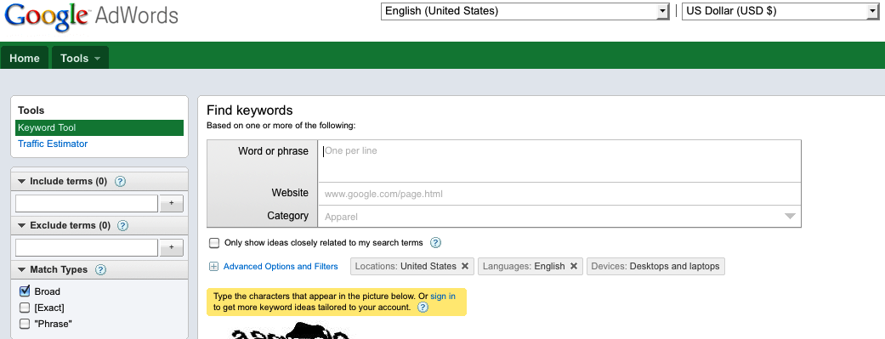
Let’s talk about what you want and what is searched
Me
You
Community
Example
Case
break out
[see template pages 39-41]
pic source: http://ephemeralnewyork.files.wordpress.com/2010/04/cornercoffeeshop.jpg
Notes:
Why Keywords Matter?*
People enter keywords into search engines in order to find information and entertainment, conduct research and make purchases. As a business, you want online searchers to find you and your company’s website when they make queries relevant to your product or service. That’s why doing the right keyword research is essential and can help you attract more qualified traffic to your site.
How Google’s Keyword Tool Works
You can do two things by going to the website:
1) Enter keywords and the Keyword Tool will return synonyms of those keywords.
2) Enter a a website and the Keyword Tool suggest keywords used within that website
Monthly Searches Help Strategize
Google’s Keyword Tool will also inform you on the monthly searches for keywords (approximately 12-month average of user queries). When you specify a country or a language in your search, you can also look into the local monthly searches. So if you’re a local company or a company looking to expand nationally or internationally, this strategy will work to your benefit.
Long tail strategy. Not just “eductaion”, but “youth education program Massachusetts”

Slide 21
Q: Where to start? A: By listening
Me
You
Community
The best social media strategy starts with ~3 to 6 months of listening:
Start on other sites and seeing what they are talking about – then comment
COMMENT on influential blogs in your community, industry, complementary industries, and prospective client’s markets
When you COMMENT, post informative, quality info to position yourself as an expert – this is not a sales pitch
Develop a community – allow COMMENT and respond to them
Incorporate subscription and user tracking tools
People don’t care what you say until you care about what they say
Create content worth linking to
Content is remarkable when someone defines it as remarkable, not when your marketing or product manager define it as remarkable. This is the greatest challenge in today’s world of marketing.
You really have no control over your product’s value, however, you do have control about hosting and socializing with people who will advocate, refer, and recommend your service or product.
Your strategy relies on enabling others.
Notes:
Know what Google search engines value]

Slide 22

The Google meritocracy
Me
You
Community
Focus on the keywords and phrases that your buyers use
Google, and all search engines, provide answers to questions
Don’t like the answers you get, tweak the question and try again
Answers come back based on meritocracy
  Authority
  Relevance
Think like a publisher
Offer solutions for each buying persona
Show off your expertise
Link content to the place where action occurs
Think like a publisher
Go to GoogleKeywordTool.com*:
  Enter a keyword you want to be ranking for.
  Find out synonymous keyword combinations.
  Choose one low on competition & with decent monthly traffic.
  Write a blog post around it.
Notes:
Why do I have Google and YouTube – both answer questions
*HubSpot.com
Qualities for search
Robot
The best web strategy positions your web page not as a brochure or an advertisement, but a rich source of content.
The best web strategy, like the best magazine, provides content over just look – form over function. Not all of your site’s visitor’s have to be buyers, but they should leave as advocates.
Today’s marketing relies less on information (a one-way flow of thoughts and ideas) and more than ever on communication (a two-way flow of thoughts and ideas). Social media and the Internet are conversations, referrals, and filters. Like a dinner party, no one on the Internet will tolerate an individual who monopolizes the conversation or directs others to talk about only their interests.

Slide 23
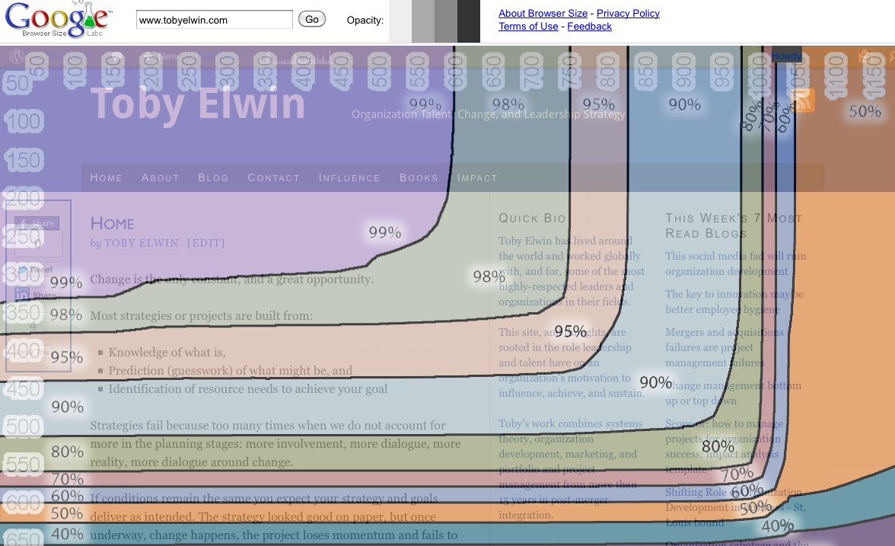
Meritocracy AND user experience matter to Google
Community
Notes:
3 seconds and 7 seconds
It's critical for websites to appear on Page 1 of Google, especially in one of the top three organic positions, as these spots receive 58.4 percent of all clicks from users, according to a new study from Optify.
Websites ranked number one received an average click-through rate (CTR) of 36.4 percent; number two had a CTR of 12.5 percent; and number three had a CTR of 9.5 percent. Being number one in Google, according to Optify, is the equivalent of all the traffic going to the sites appearing in the second through fifth positions.
Above the fold
What can they see is revealed 99% can see; 80% can see
Why is this important, calls to action
Google says: We've heard complaints from users that if they click on a result and it's difficult to find the actual content, they aren't happy with the experience. Rather than scrolling down the page past a slew of ads, users want to see content right away. So sites that don't have much content "above-the-fold" can be affected by this change. If you click on a website and the part of the website you see first either doesn't have a lot of visible content above-the-fold or dedicates a large fraction of the site’s initial screen real estate to ads, that’s not a very good user experience. Such sites may not rank as highly going forward.

Slide 24
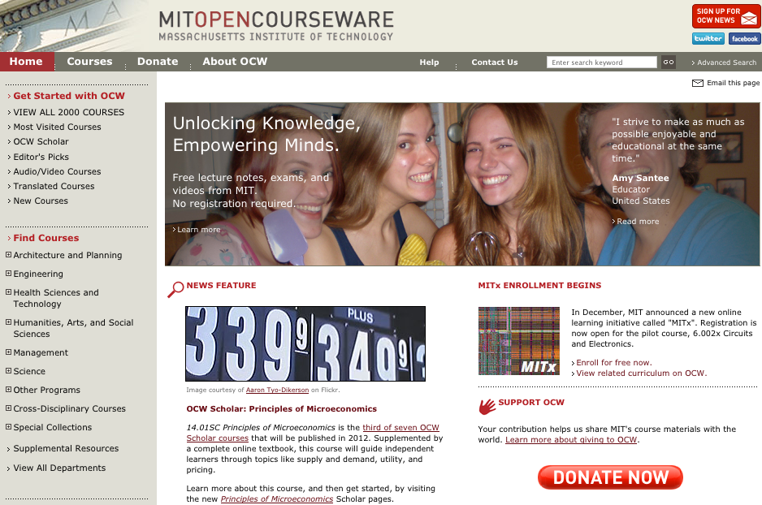

Pardon the interruption from MIT
Community
Understand your audience has the same distribution as you do, they can blog and Tweet faster than you or your hierarchy can edit and control spin;
Understand who your audience is, don't try to own your audience, provide value to your audience; understand what your audience values, not the features or benefits you want to sell;
  Lose control; if you want us to sign up, we move on;
  Lose control, stop asking for a wall of information that you want to build your leads database;
If you provide valued content and there is a link, people will find and recommend you
Notes:
http://ocw.mit.edu/index.htm
http://mitx.mit.edu/
would you rather have 100 leads of dubious quality or 10,000 downloads and 50 responses?
MIT OpenCourseWare
In 2011, MIT OpenCourseWare celebrated its first decade of making teaching materials used in MIT undergraduate and graduate courses available on the web, free of charge, to any user anywhere in the world. OCW is not a degree-granting or credit-bearing initiative, but a large-scale, web-based publication of MIT course materials. Educators are encouraged to use materials for curriculum development, and self-learners may draw on materials for self-study or supplementary use, including learning resources specially developed for high school students.
Recently, OCW launched study groups associated with OCW courses in collaboration with OpenStudy; a new series, OCW Scholar courses; and OCW LectureHall, a new iPhone application that provides an enhanced experience for viewing OCW lectures on that platform.

Slide 25
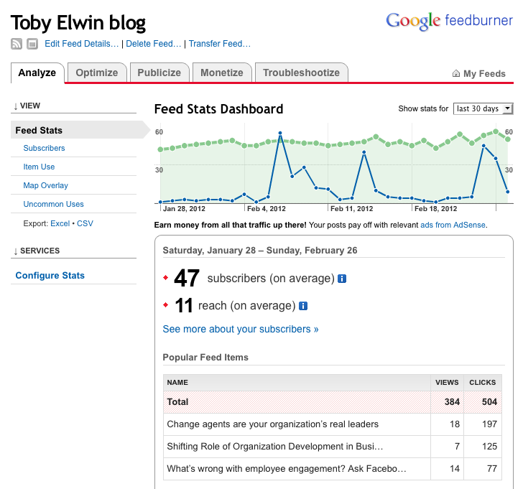
ROI Return on Investment or Return on Involvement
Me
You
Community

Slide 26
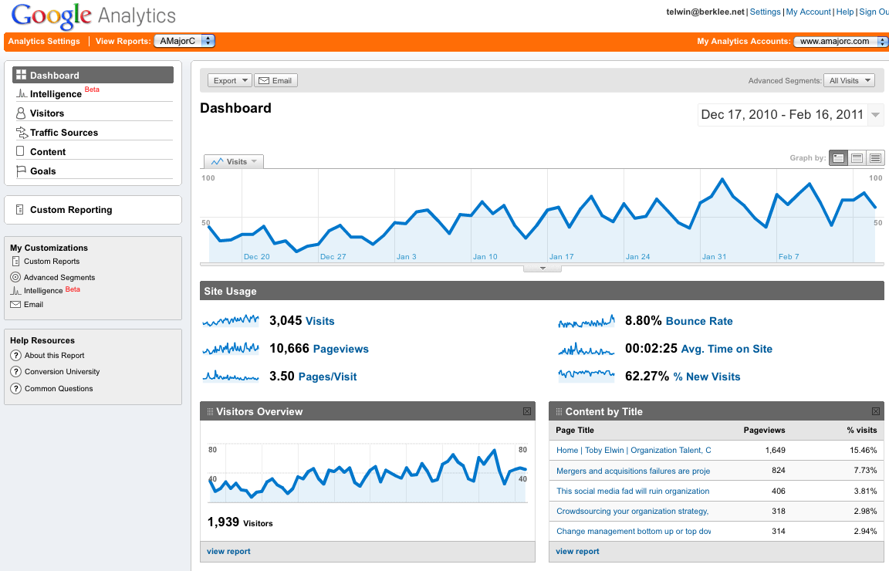
Analyzing return on involvement
Community

Slide 27
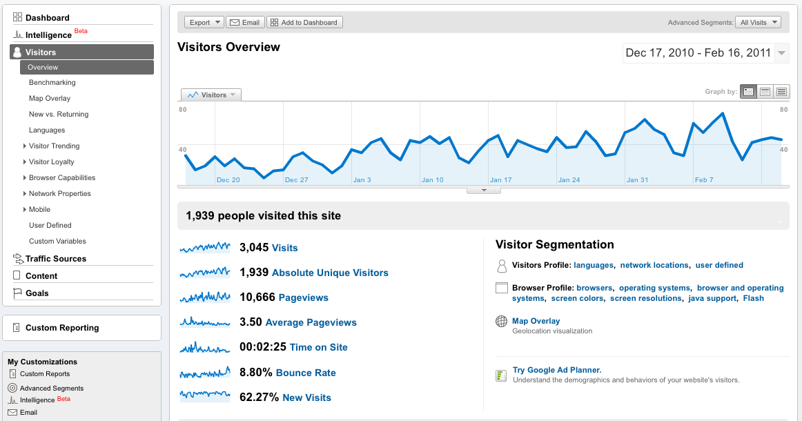
Benefit cost analysis
Community

Slide 28
What did they look at?
Community

Slide 29
Where are they coming from?
Community

Slide 30
What did they view?
Community

Slide 31
What did they click on?
Me
You
Community

Slide 32
Me
You
Community

Slide 33
Who did they share with?
Me
You
Community

Slide 34
The new breed
Me
You
Community
Notes:
Herzberg
Schein
McClennon
Ulrich

Slide 35
Communities to seek out
Me
You
Community
Blogs
Seth Godin - sethgodin.typepad.com
Mike Volpe - mikevolpe.com
Corvida Raven - shegeeks.net
Chris Brogan - chrisbrogan.com
Introduction: Search Engine, Web Strategy, and Technology
HubSpot.com
InboundMarketing.com
NewSiteMediaGroup.com
HubSpot.tv
SEOmoz.org
SearchEngineWatch.com
TopRankMarketing.com
User Interface
User Interface Engineering - uie.com/brainsparks (brilliant OD angle)
Marketing
DavidMeermanScott.com
BrianSolis.com
Adelle Revella-buyerpersona.com
Human Resources
FistfulofTalent.com
HRCapitalist.com
Twitter:
  @HubSpot
  @incentintel
  @socialmedia247
  @socialmedia630
  @BrianSolis
  @cydtetro
  @SocialMediaClub
  @KarenRubin
  @SteinarKnutsen
  @mvolpe

Slide 36
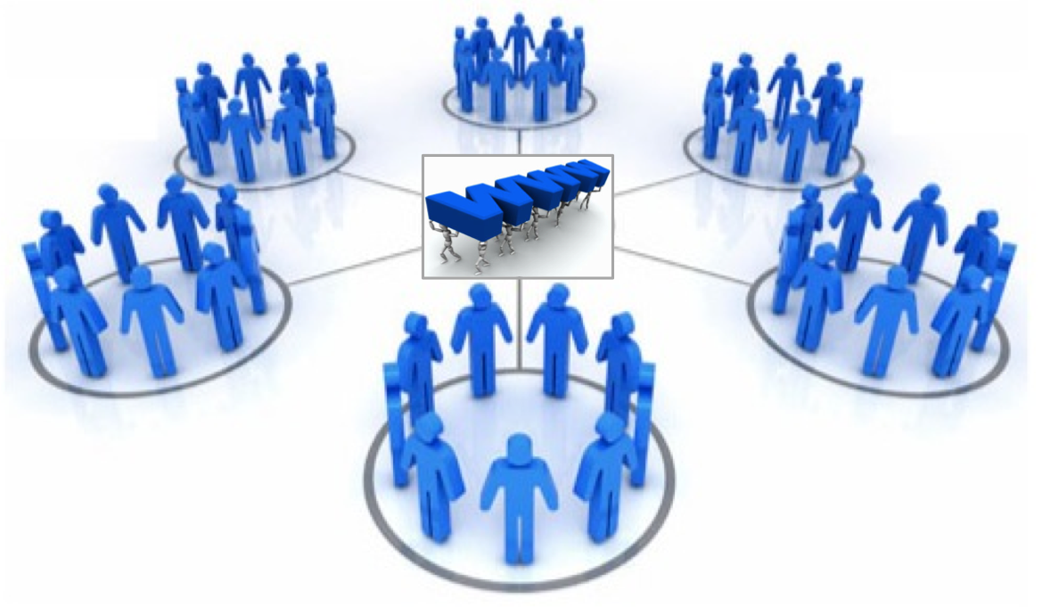
Get found, be sticky, calls to community action
Me
You
Community
pic source modified from: http://www.s3talentmanagement.com/images/graphic-development_center.jpg

Slide 37
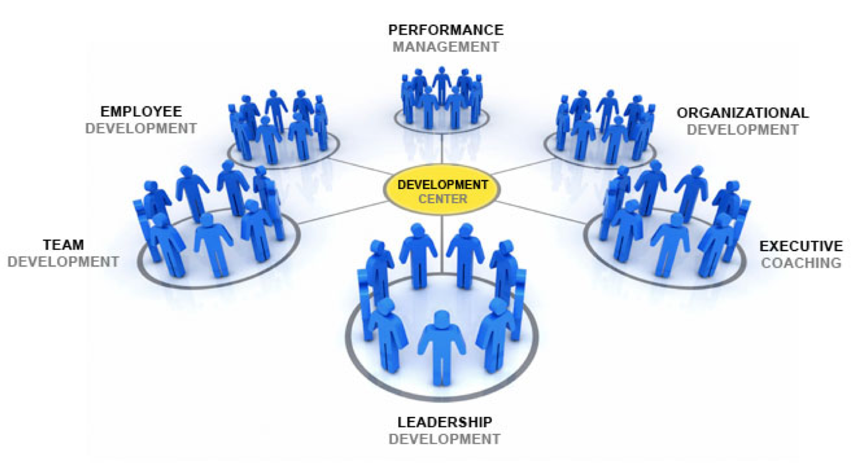
The principles of the best organization development
Me
You
Community
www.TobyElwin.com
pic source: http://www.s3talentmanagement.com/images/graphic-development_center.jpg

Slide 38
Appendix 1

Slide 39
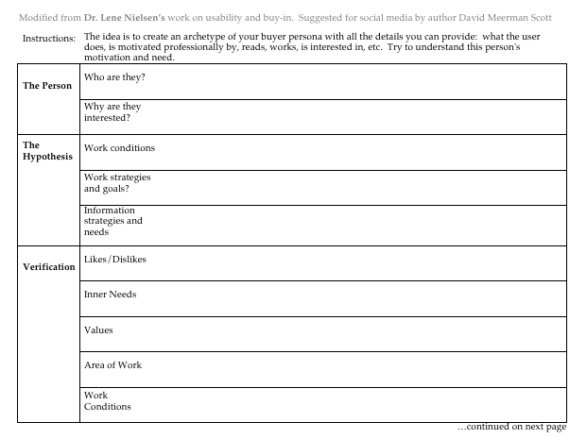
Persona and keyword breakout 1 of 3
You
Persona matrix worksheet modified from Lene Nielsen PhD http://www.hceye.org/HCInsight-Nielsen.htm

Slide 40
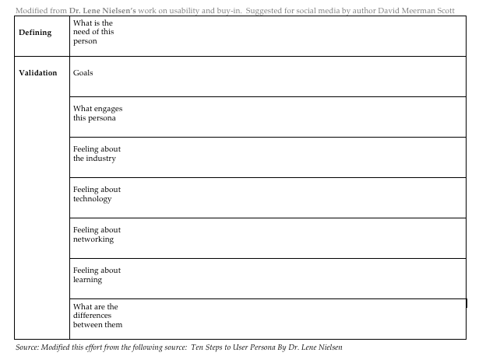
Persona and keyword breakout 2 of 3
You
Persona matrix worksheet modified from Lene Nielsen PhD http://www.hceye.org/HCInsight-Nielsen.htm

Slide 41
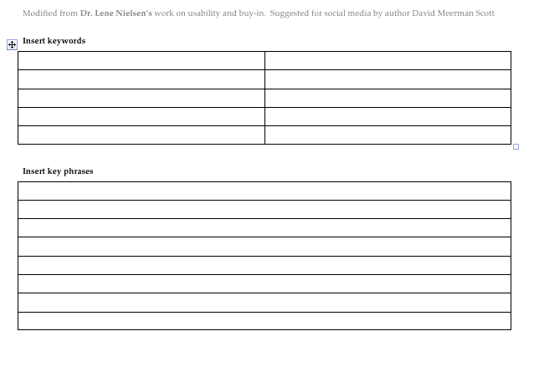
Persona and keyword breakout 3 of 3
You

Slide 42
Appendix 2

Slide 43
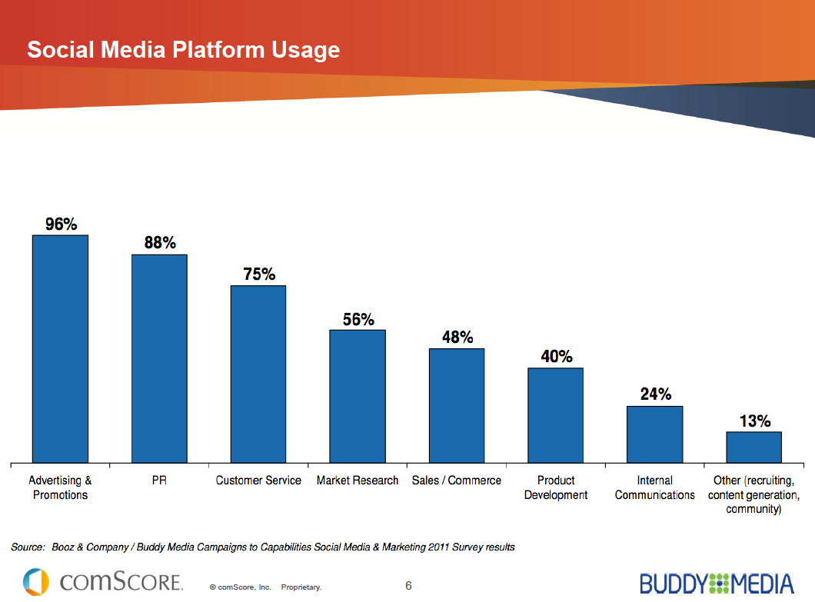
Appendix 2

Slide 44
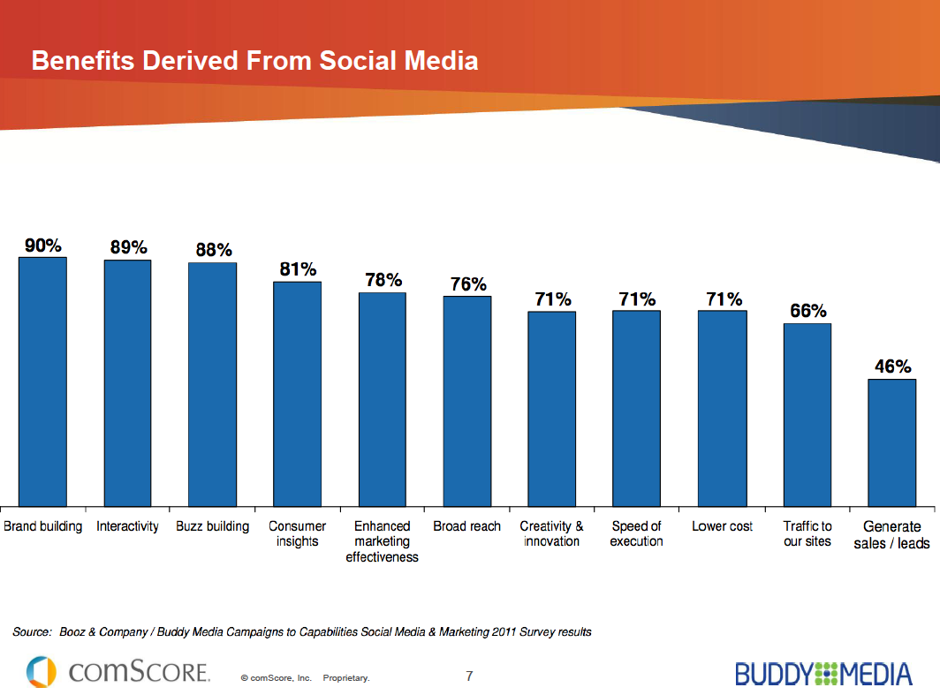
Appendix 2

Slide 45
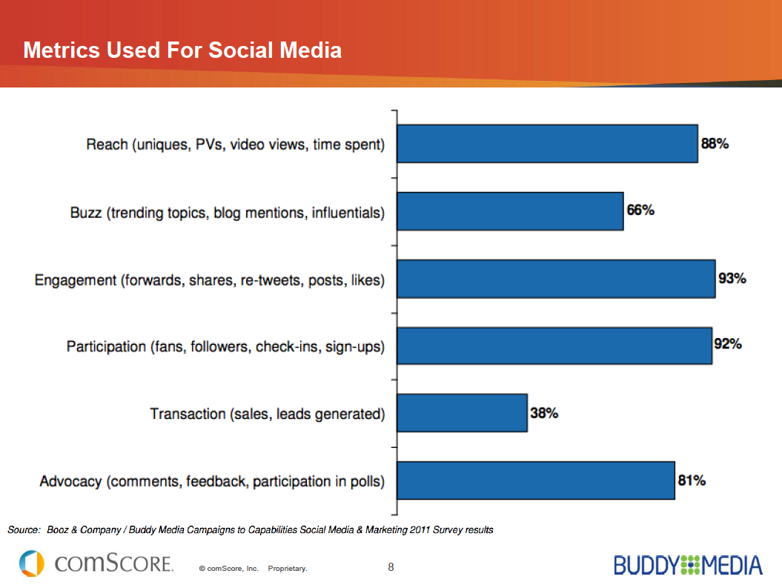
Appendix 2

Slide 46
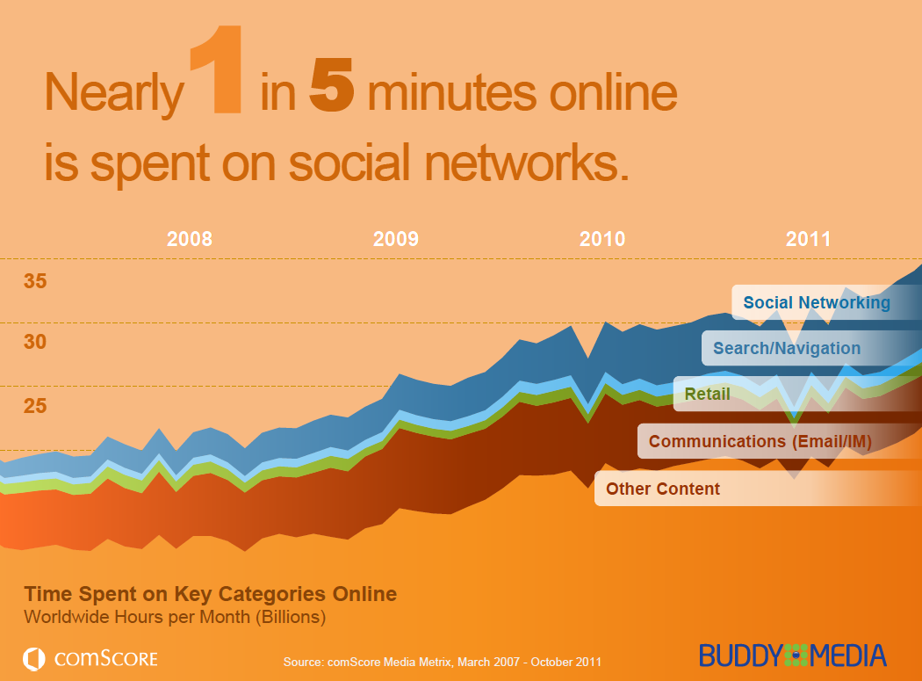
Appendix 2

Slide 47
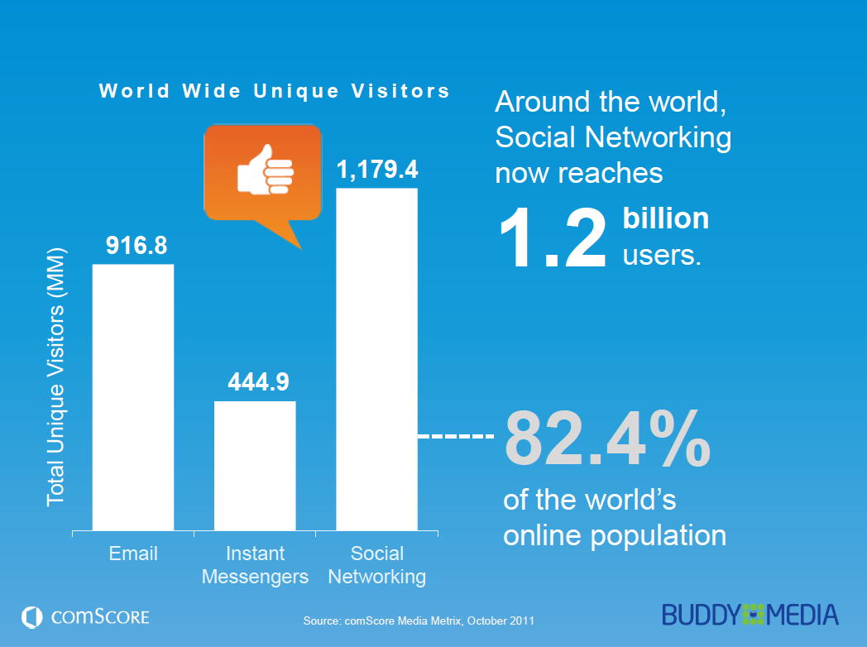
Appendix 2

Slide 48



The Social Media Data Stacks
“The Social Media Data Stacks” is part of Watershed Publishing’s Data Insights series featuring trends, data and research. This collection brings together months of surveys, reports and insights released by nationally recognized research and marketing organizations focused on keeping pace with the latest data about social media – its growth and use.
The charts in this collection are ready to use, download, format, and otherwise support your marketing goals. Feel free to share the whole presentation or any slide, with your colleagues and business partners, but please preserve credits to our sponsor, HubSpot, our research partners who provide the source data, and our links to MarketingCharts.com.
DATA INSIGHTS
Appendix 2

Slide 49
The Social Media Data Stacks
Social media is a powerful force. Consider these facts.
  Social media site users spend an average of 5.4 hours a month engaged in networking sites.
  Facebook attracts 734.2 million unique visitors a month.
  Half of TV viewers tweet about TV shows.
It is little wonder that marketers work so hard to keep pace of the social media momentum.
In MarketingCharts’ “The Social Media Data Stacks” you will get the latest data on the incredible reach and influence of Facebook and other social media sites, as well as critical information on how marketers are reacting to and budgeting for social media.
One of the most surprising statistics is that 68% of CMOs report that they feel “unprepared” for the challenges of social media marketing. Many of the 45 charts and accompanying analysis will help provide you with key data that can explain why social media marketing is so challenging, and when done well, so rewarding.
We hope you’ll find the information in this data stack helpful to your social media marketing efforts.
  Enjoy! ,
  The HubSpot Team .
Appendix 2

Slide 50

Site Usage Grows from 8% to 65%
Social Network Site Use Growth
% of online adults, 2005-2011
Source: Pew Internet & American Life Project
Pew Research found that two-thirds of adult internet users (65%) now use a social networking site like MySpace, Facebook or LinkedIn, up almost 7% from one year ago (61%), and this is about eight times the 8% who said they used social networking sites in 2005.
Looking at usage on a typical day, 43% of online adults use social networking. Out of all the “daily” online activities that Pew polls about, only email (which 61% of internet users access on a typical day) and search engines (which 59% use on a typical day) are used more frequently than social networking tools.
Appendix 2

Slide 51
68% of CMOs Challenged by Social Media
Marketing Challenges Reported by CMOs
% of respondents, October 2011
Source: IBM
Nearly seven in 10 (68%) global chief marketing officers (CMOs) feel unprepared for the demands of social media marketing, according to a study released by IBM. This is second only to the 71% who are challenged by the so-called marketing “data explosion.”
A large portion of CMOs also feel unprepared for growth of channel and device choices (65%), shifting consumer demographics (63%) and financial constraints (59%).
Appendix 2

Slide 52
Consumers Expect Something for “Like”
Consumer Expectations for Brand Liking
% of Facebook users, September 2011
Source: ExactTarget
EaxctTarget reports that more than six in 10 (63%) Facebook users who “like” a brand or product on Facebook expect something in return. Results from “The Meaning of Like” indicate that a leading 58% of Facebook likers expect both access to exclusive content, events or sales, and discounts or promotions through Facebook. Only 37% do not expect anything to happen.
Appendix 2

Slide 53
8 in 10 Connect to Brands on Facebook
Preferred Social Network for Brand Connection
% of social network users, May 2011
Source: Edison Research and Arbitron
Edison Research and Arbitron found that 80% of US social network users preferred to connect with brands through Facebook. This dwarfs all other social media networks, with Twitter in a tie with “Don’t Know” for a very distant second place, at 6% of users.
Appendix 2

Slide 54
SocNet Users Want Deals, Discussion
Social Media Use for Products/Services Information
% of respondents, October 2011
Source: NM Incite
NM Incite found that social network users see the platforms as a useful shopping and research tool, and participate with the desire to view and contribute to reviews of products and services. 68% of social media users (71% of parents and 64% of non-parents) go to social networking sites to read product reviews and more than half use these sites to provide product feedback, both positive and negative.
Getting coupons is also popular, with 58% overall usage (64% of parents and 56% of non-parents).
Appendix 2

Slide 55
Social Sites Impact 35% of Shoppers
Community, Social Tools that Impact Buying
% of respondents, June 2011
Source: e-tailing group, PowerReviews
About six in 10 (59%) online shoppers say user-generated customer product reviews have a significant or good impact on their buying behavior, according to the e-tailing group and PowerReviews.
Community forums influence 26% of shoppers. The social media sites, altogether, influence the buying behavior of 35% of online shoppers: Facebook fan pages affect 13% of online shoppers; the Facebook newsfeed influences another 13% and Twitter, another 9%.
Appendix 2

Slide 56
On Average, 29% Seek Purchase Advice
Social Networks as a Source of Purchasing Advice
% of respondents who sought advice, June 2011
Source: ROI Research and Performics
Social networks are a resource, with an average of 29% of consumers seeking buying advice. Less than half of online consumers obtain purchase advice on products in any vertical covered by the survey, with appliances the most popular at 46%. The only other vertical which more than four in 10 online consumers said they go to social networks to receive purchase advice for was electronics (42%).
Appendix 2

Slide 57
Active SocNet Users Take It Offline
Lifestyle Habits of Active Social Network Users
% of total, compared to average internet users, Q3 2011
Source: The Nielsen Company
Active social network users, according to Nielsen, are 75% more likely to spend heavily on music and 47% more likely to heavily spend on clothing, shoes and accessories. They are 45% more likely to go on a date. Other areas where heavy social network users show more likelihood of participating include giving opinions on TV programs (33%), giving opinions on politics and current events (26%), attending professional sporting events (19%) and working out at a gym or health club (18%).
Appendix 2

Slide 58
Sports, Education Lead Discussions
Product Discussion via Social Networks
% of respondents who had discussion in vertical June 2011
Source: ROI Research and Performics
The ROI research survey asked consumers about their discussions on a variety of vertical products on social networks. About eight in 10 (79%) online consumers indicated they discuss educational institutions and sports-related products. Other verticals generating social network discussions with a high rate of consumers include entertainment (74%), automotive (67%) and electronics (63%).
Appendix 2

Slide 59

Appendix 2

Slide 60


Data Partners
Our data sources for “The Social Media Data Stacks” are:
ACSI / Foresee Results  Adobe and Econsultancy  Altimeter Group  Arketi Web Watch 
e-tailing group and PowerReviews  ExactTarget  IBM  IgnitionOne  Internet Advertising Bureau  Janrain  The Nielsen Company  NM Incite  Pew Internet & American Life Project  ROI Research and Performics  SocialMedia Examiner  TVGuide.com  WebLiquid and RSW/US
At MarketingCharts, we consistently follow and locate new data sets from our partners in order to publish the most relevant resources for our readers, including our data partners at MarketingCharts.com that are also featured in this report:
MarketingCharts.com is part of the Watershed Publishing network of business-to-business online trade publications. The Social Media Data Stacks is from Watershed Publishing’s Data Insights series.
Please contact Sarah Roberts at sarah@watershed-publishing.com to become a sponsor of a Data Insights package.
Appendix 2

